Slide 1
Pipelining I
Prepared by: Noshaba Nasir

Slide 2
What Is Pipelining?
Pipelining is an implementation technique whereby multiple instructions are overlapped in execution.
It takes advantage of parallelism that exists among the actions needed to execute an instruction.
Today, pipelining is the key implementation technique used to make fast CPUs.

Slide 3
Real World Analogy
A pipeline is like an assembly line.
In an automobile manufacturing line, there are many steps, each contributing something to the construction of the car.
Each step operates in parallel with the other steps, although on a different car.

Slide 4
Real World Analogy
Automobile manufacturing line without pipelining, in 3 stages
Assemble (A), Paint (P), Fix tires (T)
Assuming A+P+T take 3 hours
Time line | 0-3 hours | 3-6 Hours | 6 -9Hours
Car 1 | A+P+T
Car 2 |  | A+P+T
Car 3 |  |  | A+P+T

Slide 5
Real World Analogy
Automobile manufacturing line with pipelining, in 3 stages
Assemble (A), Paint (P), Fix tires (T)
Assuming each stage takes 1 hour
It takes 5 hours with pipelining and 9hours without pipelining
Speedup = 9/5
Time line | 1st hour | 2nd hour | 3rd hour | 4th hour | 5th hour | 6th hour | 7th hour | 8th hour | 9th hour
Car 1 | A | P | T
Car 2 |  | A | P | T
Car 3 |  |  | A | P | T

Slide 6
Real World Analogy
Here our assumptions are
There is no time consumed to transition car from one working station on other
All the stages consume equal time
However these assumption are not valid
Each stage can take different amount of time
For example painting a car takes 2 hours and Assembly and installing types take 0.5 hours each
To transfer car from one stage to another will take time.
For example, it takes 10 minutes to transfer a car from Assembly room to paint rooms and 10 minute to transfer from paint room to tire fixing room.
Note that this will not be consume in un-pipeline factory as everything will be done is same room

Slide 7
Real World Analogy
Automobile manufacturing line with pipelining, in 3 stages
If Assemble (A), Paint (P), Fix tires (T) take different time
If Assembly take 0.5 hour, Paint 2 hours and Tires 0.5 hours
Paint of Car2 cannot start before 2.5th hour because Paint unit is busy with Car1. So after Assembly Car 2 has to wait for 1.5 Hours
Total time take to complete 3 instructions =7h
Speed Up = 9/7
Time line | 0-0.5h | 0.5-2.5h | 2.5-4.5h | 4.5-6.5 h | 6.5-7 h
Car 1 | A (0.5 h) | P (2h) | T (0.5h)
Car 2 |  | A (0.5 h) +wait for 1.5 h | P (2h) | T (0.5h)
Car 3 |  |  | A (0.5h)+ wait for 1.5 h | P (2h) | T (0.5h)

Slide 8
Real World Analogy
Automobile manufacturing line with pipelining, in 3 stages
If we add time for transition between stages as well
Total time taken to complete 3 instructions = 7h+40m=7.67h
Speed Up = 9/7.67
Time line | 0-0.5h | Transition time 10 min | 0.5 +10m-2.5h+10m | Transition time 10 min | 2.5h+20m-4.5h+20m | Transition time 10 min | 4.5h+30m-6.5 h+30m | Transition time 10 min | 6.5h+40m -7 h+40m
Car 1 | A (0.5 h) |  | P (2h) |  | T (0.5h)
Car 2 |  |  | A (0.5 h) +wait for 1.5 h |  | P (2h) |  | T (0.5h)
Car 3 |  |  |  |  | A (0.5h)+ wait for 1.5 h |  | P (2h) |  | T (0.5h)

Slide 9
Real World Analogy::Throughput and Latency
In case of car manufacturing throughput is number of cars create per hour
From slide 8 throughput with pipelining is 3 Cars/ 7.67 Hours ~0.4 Cars/hour
From slide 4 throughput without pipelining is 3Cars/9Hours ~ 0.33Cars/hour
So we can see that the throughput with pipelining is higher.
Latency is time taken to complete one car
From slide 8 latency with pipelining is 4.5 hours (4.5 hours consumed to create car2 and 3)
From slide 4 latency without pipelining is 3 hours (3 hours consumed to create each car)
So we can see that latency is worse with pipelining
Observation: Pipeline does not improve latency, it only improves throughput

Slide 10
Throughput and latency for n=3
Case | Latency | Throughput | Speed up
Non pipeline | 3 | 3/9=0.33 | NA
Pipeline ideal case | 3 | 3/5=0.6 | 9/5
Pipeline with all stages not of equal time | 4.5 | 3/7=0.42 | 9/7
Non ideal case with latch time | 4.833 | 3/7.67=0.39 | 9/7.67

Slide 11
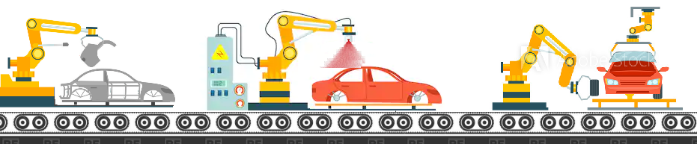
Real World Analogy:: Process Cycle
The time required between moving an object one step down the pipeline is a processor cycle
Assume that all stages procced at the same time
There is only one conveyer belt and it only moves cars to next step when longest stage is complete, i.e. every two hours.*
Processor cycle will be 2 hours
Even the car in T stage will be there for 2 hours and will only come out of pipeline when 2 hours of P(of other instruction are completed)
Notes:
Its easier if program the conveyer belt in this way. i.e. move ahead every 2 hours as we will be sure that all the stages were complete before preceding.
This will be more clear when we will talk about pipelining in computers.

Slide 12
Real World Analogy:: Process Cycle
Consider process cycle to be 2 hours, throughput with pipelining is 3 Cars/ 10 Hours ~0.3 Cars/hour
This is even worse than throughput of un-pipeline
This issue can be resolve if stages are more or less of equal time duration (paint job can be further divided into smaller stages)
Time line | 2hour | 2hours | 2hours | 2hours | 2hours
Car 1 | A | P | T
Car 2 |  | A | P | T
Car 3 |  |  | A | P | T

Slide 13
Exercise
Divide your paint job in 4 stages, 1st coat, 2nd coat, 3rd coat and drying , each phase takes 0.5 hours.
What will be throughput with these 6 stages for 3 cars?
Ignore the latch/transition time

Slide 14
Pipeline in Computer
In a computer pipeline, each step in the pipeline completes a part of an instruction.
Like the assembly line, different steps are completing different parts of different instructions in parallel.
Each of these steps is called a pipe stage or a pipe segment.
The stages are connected one to the next to form a pipe—instructions enter at one end, progress through the stages, and exit at the other end, just as cars would in an assembly line

Slide 15
Pipeline in Computer:: Stages
The number of stages in which one instruction can be divided is difference from processor to processor.
If we only create two stages Fetch Instruction (FI) and Execute Instruction (EI), EI will take a lot more time than FI.
To get a better throughput and speedup pipeline must have more stages.
The pipeline designer’s goal is to balance the length of each pipeline stage

Slide 16
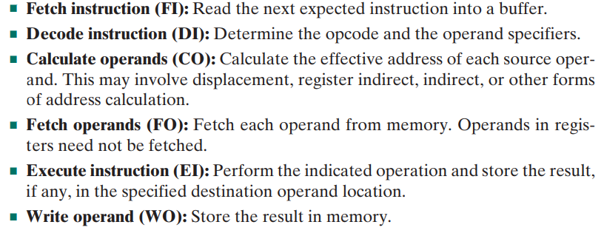
Pipeline in Computer:: Stages
Let us consider the following decomposition of the instruction processing
With this decomposition, the various stages will be of more nearly equal duration. For the sake of illustration, let us assume equal duration. Using this assumption, next slide shows that a six-stage pipeline can reduce the execution time for 9 instructions from 54 time units to 14 time units.

Slide 17
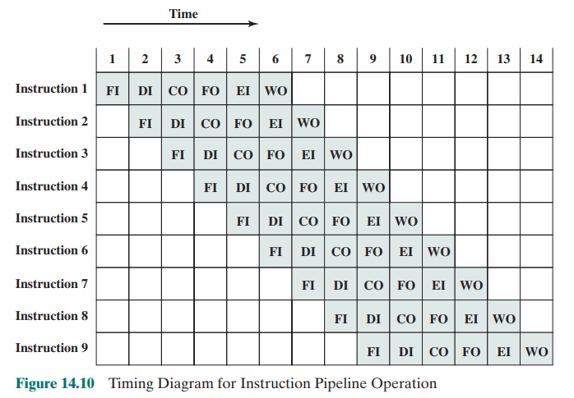
Pipeline in Computer:: Stages
Six-stage pipeline can reduce the execution time for 9 instructions from 54 time units to 14 time units.
Throughput with pipeline= 9/14
Throughput without pipeline= 9/54
Speedup= 54/14
Note that the figure is for ideal case in reality all the instructions might not require to go through all these stages
For example: in load operations WO is not required
If operand are register FO is not required

Slide 18
Pipeline in Computer:: Clock Cycle
The time required between moving an instruction one step down the pipeline is a processor cycle
Because all stages proceed at the same time, the length of a processor cycle is determined by the time required for the slowest pipe stage, just as in an auto assembly line
The longest step would determine the time between advancing the line
In a computer, this processor cycle is usually 1 clock cycle
One cell in figure 14.10 is 1 clock cycle

Slide 19
Pipeline in Computer:: Clock Cycle
For example in if
FI DI CO FO EI WO each takes 1 us
Clock cyle should be of 1us
Although this is the ideal case
For example if
FI takes 5 us, DI takes 1us, CO takes 1us, FO takes 10us, EI takes 1us, and WO also takes 10us
Clock cyle should be of 10us
For example in processor with no pipelining
If one instruction takes 10us then clock cycle should 10us

Slide 20
Pipeline in Computer:: Frequency
Computer processors can execute one or more instructions per clock cycle, depending on the type of processor.
Frequency of computer is 1/clock cycle
For example if 1 clock cycle= 10 ms;
Frequency = 1/10ms= 1MHZ
i.e. 1 000 000 cycles / second
Frequency is AKA as clock speed

Slide 21
Pipeline in Computer:: Performance
IDEAL CASE
In ideal case i.e. all the stages require same amount of time and ignoring time to transfer data from one stage to another
Speedup= n*k/ k+(n-1)
where n is number of instructions and k is number of stages
Time line | T | T | T | T | T
Car 1 | A | P | T
Car 2 |  | A | P | T
Car 3 |  |  | A | P | T
.. |  |  |  | … | ..

Slide 22
Pipeline in Computer:: Performance Ideal case (Derivations)
If
All stages take equal amount of time T
Latch time=0
Stages =k
Number of instructions = n
Then
Clock cycle of pipeline=T, clock cycle of non pipeline= k*T
Frequency of pipeline=1/T , Frequency of non pipeline=1/k*T
Time taken to complete n instructions without pipeline= n*k*T= n*clock cycle of non pipeline
Through put for n instructions without pipeline= n/ n*k*T
Time taken to complete n instructions with pipeline= (k+n-1)*T= (k+n-1)*(Clock Cycle of pipeline)
Through put for n instructions with pipeline= n/ (k+n-1)*T
Speedup for n instructions = n*k*T/ (k+n-1)*T = n*k/ (k+n-1)
Latency without pipelining = k*T
Latency with pipelining= k*T

Slide 23
Pipeline in Computer:: Performance Ideal case
Numerical:
It takes 6us to complete one instruction in non-pipeline processor
We were able to convert the circuit into 6 equal sequential pipeline stages.
Assume latch time is 0
Answer the following, assuming that there are no stalls in the pipeline.
What are the clock cycle in the two processors?
What are the clock speeds(frequency) in two processors?
How long does it take to finish one instruction in pipeline and no pipeline (latency )?
What is the throughput for 100 instructions without pipelining?
What is the throughput for 100 instructions with pipelining?
What is the speedup from pipelining for 1 instructions?
What is the speedup from pipelining for 100 instructions?

Slide 24
Pipeline in Computer:: Performance
NON-IDEAL CASE I
In non ideal case where all stages do not take same amount of time and ignoring latch time
Speedup= n* T₁ / (k+(n-1))* T ₂
Where n is number of instruction, k is number of stages, T₁ time require by one instruction to complete in non pipeline processor and T₂ is max time require by any stage in pipeline processor
Time | T ₁ | T ₁ | T 1
Car 1 | A+P+T
Car 2 |  | A+P+T
Car 3 |  |  | A+P+T
..
Time | T ₂ | T ₂ | T ₂ | T ₂ | T ₂
Car 1 | A | P | T
Car 2 |  | A | P | T
Car 3 |  |  | A | P | T
.. |  |  |  | … | ..
Without pipelining
With pipelining

Slide 25
Pipeline in Computer:: Performance Non Ideal case (Derivations)
If all stages do not take same time
Non pipeline processor takes T1 time to complete one instruction
In pipeline processor max time take by any stage is T2
Latch time=0
Stages =k
Number of instructions = n
Then
Clock cycle of pipeline processor = T2, Clock Cycle of processor without pipelining = T1
Frequency of pipeline processor =1/T2, Frequency of processor without pipelining = 1/T1
Time taken to complete n instructions without pipeline= n*T1= n*clock cycle of non pipeline
Through put for n instructions without pipeline= n/ n*T1
Time taken to complete n instructions with pipeline= (k+n-1)*T2 =(k+n-1)*(Clock Cycle of pipeline)
Through put for n instructions with pipeline= n/ (k+n-1)*T2
Speedup for n instructions = n*T1/ (k+n-1)*T2
Latency without pipelining = T1
Latency with pipelining= K*T2

Slide 26
Pipeline in Computer:: Performance
Example NON-IDEAL
It takes 6us to complete one instruction in non-pipeline processor
We were able to convert the circuit into 6 sequential pipeline stages.
Stage 1 and 2 take 2us each and stage 3-6 take 0.5us each
Assume latch time is 0
Answer the following, assuming that there are no stalls in the pipeline.
What are the clock cycle in the two processors?
What are the clock speeds(frequency) in two processors?
How long does it take to finish one instruction in pipeline and no pipeline (latency )?
What is the throughput for 100 instructions without pipelining?
What is the throughput for 100 instructions with pipelining?
What is the speedup from pipelining for 1 instructions?
What is the speedup from pipelining for 100 instructions?

Slide 27
Pipeline in Computer:: Performance
Including latch time
Speedup= n* T₁ / (k+(n-1))* (T₂+ T3)
Where n is number of instruction, k is number of stages, T₁ time require by one instruction to complete without pipeline, and T₂ is max time require of all the stages, T3 is latch time (same as transfer time as explained in slide 8)
Time | T ₂ | Latch time T3 | T ₂ | Latch time T3 | T ₂ | Latch time T3 | T ₂ | Latch time T3 | T ₂ | Latch time T3
Car 1 | A |  | P |  | T
Car 2 |  |  | A |  | P |  | T
Car 3 |  |  |  |  | A |  | P |  | T
.. |  |  |  |  |  |  | … |  | ..

Slide 28
Pipeline in Computer:: Performance Non Ideal case with latch time (Derivations)
If all stages do not take same time
Non pipeline processor takes T1 time to complete one instruction
In pipeline processor max time take by any stage is T2
Latch time=T3
Stages =k
Number of instructions = n
Then
Clock cycle of pipeline processor = T2+T3, Clock Cycle of processor without pipelining = T1
Frequency of pipeline processor =1/(T2+T3), Frequency of processor without pipelining = 1/(T1)
Time taken to complete n instructions without pipeline= n*T1= n*clock cycle of non pipeline
Through put for n instructions without pipeline= n/ n*T1
Time taken to complete n instructions with pipeline= (k+n-1)*(T2+T3)= (k+n-1)*(Clock Cycle of pipeline)
Through put for n instructions with pipeline= n/ (k+n-1)*(T2+T3)
Speedup for n instructions = n*T1/ (k+n-1)*(T2+T3)
Latency without pipelining = T1
Latency with pipelining= K*(T2+T3)
This slide covers all the formulas that you have seen earlier, for example of latch time 0 then you will get same equations are given on slide 26

Slide 29
Pipeline in Computer:: Performance
Example NON-IDEAL CASE with latch time
It takes 6us to complete one instruction in non-pipeline processor
We were able to convert the circuit into 6 sequential pipeline stages.
Stage 1 and 2 take 2us each and stage 3-6 take 0.5us each
Latch time is 2us
Answer the following, assuming that there are no stalls in the pipeline.
What are the clock cycle in the two processors?
What are the clock speeds(frequency) in two processors?
How long does it take to finish one instr in pipeline and no pipeline (latency )?
What is the throughput for 100 instructions without pipelining?
What is the throughput for 100 instructions with pipelining?
What is the speedup from pipelining for 1 instructions?
What is the speedup from pipelining for 100 instructions?

Slide 30
Pipeline in Computer:: Performance
Another example
It takes 5us to complete one instruction in non-pipeline processor
We were able to convert the circuit into 5 equal duration sequential pipeline stages.
Latch time is 0us
Answer the following, assuming that there are no stalls in the pipeline.
What are the clock cycle in the two processors?
What are the clock speeds(frequency) in two processors?
How long does it take to finish one instr in pipeline and no pipeline (latency )?
What is the throughput for 100 instructions without pipelining?
What is the throughput for 100 instructions with pipelining?
What is the speedup from pipelining for 1 instructions?
What is the speedup from pipelining for 100 instructions?

Slide 31
Pipeline in Computer:: Performance
Another example
It takes 5us to complete one instruction in non-pipeline processor
We were able to convert the circuit into 5 equal duration sequential pipeline stages.
Latch time is 0.2us
Answer the following, assuming that there are no stalls in the pipeline.
What are the clock cycle in the two processors?
What are the clock speeds(frequency) in two processors?
How long does it take to finish one instr in pipeline and no pipeline (latency )?
What is the throughput for 100 instructions without pipelining?
What is the throughput for 100 instructions with pipelining?
What is the speedup from pipelining for 1 instructions?
What is the speedup from pipelining for 100 instructions?

Slide 32
Exercise
Question 1: If throughput of one processor1 for n instruction is 10us and through put of processor 2 is 15us for same n instruction what speed up is achieved by processor2 are compare to processor 1?
Question 2: If Latency with pipelining with 5 stages is 6us and latch time is 0 what is the clock cycle time?

